Slide 1
Databases for Data Science
SQL – Tool for Data Science
Structured Query Language (SQL) is a language designed for managing data in a relational database.
SQL has a variety of built-in functions that allow its users to read, write, update, and delete data.
It is a popular language for data analysts for a few reasons:
It can directly access a large amount of data without copying it in other applications.
It can be used to deal with data of almost any shape and massive size.
Data analysis done in SQL is easy to audit and replicate as compared to an Excel sheet or CSV file. Excel is great with smaller datasets but not useful for large-sized databases.
Joining tables, automating, and reusing code are much easier in SQL than in Excel.
SQL is simple and easy to learn.

Slide 2
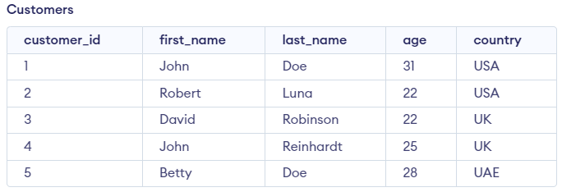


Basic Statistics with SQL: Mean
Mean Value
The average of the dataset is calculated by dividing the total sum by the number of values (count) in the dataset.
This operation can be performed in SQL by using built-in operation Avg.
SELECT Avg(ColumnName) as MEAN
FROM TableName

Slide 3
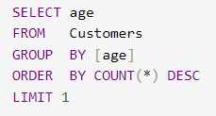
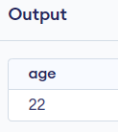
Basic Statistics with SQL: Mode
Mode Value
The mode is the value that appears most frequently in a series of the given data.
SQL does not provide any built-in function for this, so we need to write the following queries to calculate it.
SELECT ColumnName
FROM TableName
GROUP BY ColumnName
ORDER BY COUNT(*) DESC
LIMIT 1

Slide 4
Basic Statistics with SQL: Median
Median value
In a sorted list (ascending or descending) of numbers, the median value is the middle number and can be more descriptive of that dataset than the average.
For an odd amount of numeric dataset, the median value is the number that is in the middle, with the same amount of numbers below and above.
For an even amount of numbers in the list, the middle two numbers are added together, and this sum is divided by two to calculate the median value.
SQL does not have a built-in function to calculate the median value of a column.

Slide 5
Basic Statistics with SQL: Median
Emp table with Ten Employees Salary Details
SET @rindex := -1;
SELECT
AVG(m.sal)
FROM
(SELECT @rindex:=@rindex + 1 AS rowindex,
Emp.salary AS sal
FROM Emp
ORDER BY Emp.salary) AS m
WHERE
m.rowindex IN (FLOOR(@rindex / 2) , CEIL(@rindex / 2));
Salary | Name
1,000 | Amit
2,000 | Nisha
3,000 | Yogesh
4,000 | Puja
9,000 | Ram
7,000 | Husain
8,000 | Risha
5,000 | Anil
10,000 | Kumar
6,000 | Shiv
The above code will return median value 5,500 for the given Emp table.
In the above code, the internal subquery sorts salary and creates @rindex as an incremental index. The outer subquery will fetch the middle items in the array.
If the dataset contains an even number of items, then the SELECT clause of the outer query calculates the average of those two values as the median value.

Slide 6
Data Munging with SQL
Data munging (or wrangling) is the phase of data transformation.
It transforms data into various states so that it is simpler to work and understand the data.
The transformation may lead to manually convert or merge or update the data manually in a certain format to generate data, which is ready for processing by the data analysis tools.
In this process, we actually transform and map data from one format to another format to make it more valuable for a variety of analytics tools.
Some frequently used data munging functions are:
UPPER()
LOWER()
TRIM()
LTRIM()
RTRIM()
RIGHT()
LEFT()
REPLACE()

Slide 7
Data Munging with SQL: UPPER()
UPPER()
The UPPER() string function is used to convert the lower case to the upper case of the input text data.
Input:
Output:
SELECT UPPER(‘welcome to Data Science’)

Slide 8
Data Munging with SQL: LOWER()
LOWER()
The LOWER() string function is used to convert the upper case to the lower case of the input text data.
Input:
SELECT LOWER(‘WELCOME TO DATA SCIENCE’)
Output:

Slide 9
Data Munging with SQL: TRIM()
TRIM()
The TRIM() string function removes blanks from the leading and trailing position of the given input data.
Input:
SELECT TRIM(‘ WELCOME TO DATA SCIENCE ’)
Output:

Slide 10
Data Munging with SQL: TRIM()
LTRIM()
The LTRIM() string function is used to remove the leading blank spaces from a given input string.
Input:
SELECT LTRIM(' WELCOME TO DATA SCIENCE’)
Output:

Slide 11
Data Munging with SQL: RTRIM()
RTRIM ()
The RTRIM() string function is used to remove the trailing blank spaces from a given input string.
Input:
SELECT RTRIM('WELCOME TO DATA SCIENCE ‘)
Output:

Slide 12

Data Munging with SQL: RIGHT()
RIGHT()
The RIGHT() string function is used to return a given number of characters from the right side of the given input string.
Input:
SELECT RIGHT('WELCOME TO DATA SCIENCE', 7)
Output:

Slide 13

Data Munging with SQL: LEFT()
LEFT()
The LEFT() string function is used to return a given number of characters from the left side of the given input string.
Input:
SELECT LEFT('WELCOME TO DATA SCIENCE', 7)
Output:

Slide 14

Data Munging with SQL: REPLACE()
REPLACE()
The REPLACE() string function replaces all the occurrences of a source sub-string with a target substring of a given string.
Input:
SELECT REPLACE('WELCOME TO DATA SCIENCE', 'DATA', 'INFORMATION’)
Output:

Slide 15
Filtering, Joins and Aggregation
Joins
In SQL, joins are commands that are used to combine rows from two or more tables.
These tables are combined based on a related column between those tables.
Inner, left, right, and full are four basic types of SQL joins.
Venn diagram is the easiest way to explain the difference between these four types.
Employee Table
Department Table
ID | STATE
10 | AB
11 | AC
12 | AD
ID | BRANCH
11 | Computer
12 | Civil
13 | Mech

Slide 16
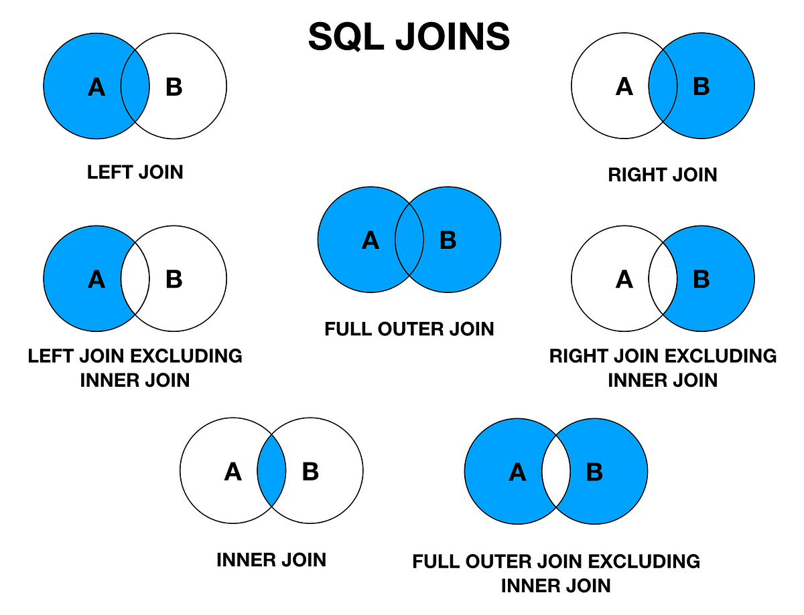

Slide 17
Inner Join
The inner join selects all rows from both tables as long as there is a match between the columns.
This join returns those records that have matching values in both tables.
Emp Table
Dept Table
ID | STATE
10 | AB
11 | AC
12 | AD
ID | BRANCH
11 | Computer
12 | Civil
13 | Mech
SELECT *
FROM Emp inner join Dept
on Emp.ID = Dept.ID;
ID | STATE | ID | BRANCH
11 | AC | 11 | Computer
12 | AD | 12 | Civil

Slide 18
Left Outer Join
The left outer join (or left join) returns all the rows of the left side table and matching rows in the right side table of the join.
The rows for which there is no matching row on the right side, the result will contain NULL.
Emp Table
Dept Table
ID | STATE
10 | AB
11 | AC
12 | AD
ID | BRANCH
11 | Computer
12 | Civil
13 | Mech
SELECT *
FROM Emp left outer join Dept
on Emp.ID = Dept.ID;
ID | STATE | ID | BRANCH
10 | AB | NULL | NULL
11 | AC | 11 | Computer
12 | AD | 12 | Civil

Slide 19
Right Outer Join
The right outer join (or right join) returns all the rows of the right side table and matching rows for the left side table of the join.
The rows for which there is no matching row on the left side, the result will contain NULL.
Emp Table
Dept Table
ID | STATE
10 | AB
11 | AC
12 | AD
ID | BRANCH
11 | Computer
12 | Civil
13 | Mech
SELECT *
FROM Emp right outer join Dept
on Emp.ID = Dept.ID;
ID | STATE | ID | BRANCH
11 | AC | 11 | Computer
12 | AD | 12 | Civil
NULL | NULL | 13 | Mech

Slide 20
Full Outer Join
The full outer join (or full join) returns all those records that have a match in either the left table (Emp) or the right table (Dept) table.
The joined table will contain all records from both the tables, and if there is no matching field on either side, then fill in NULLs.
Emp Table
Dept Table
ID | STATE
10 | AB
11 | AC
12 | AD
ID | BRANCH
11 | Computer
12 | Civil
13 | Mech
SELECT *
FROM Emp full outer join Dept
on Emp.ID = Dept.ID;
ID | STATE | ID | BRANCH
10 | AB | NULL | NULL
11 | AC | 11 | Computer
12 | AD | 12 | Civil
NULL | NULL | 13 | Mech

Slide 21

Aggregation
SQL provides the following built-in functions for aggregating data.
COUNT()
AVG()
SUM()
MIN()
MAX()
The COUNT() function returns the number of values in the dataset.
SELECT COUNT(customer_id)
FROM Customers;

Slide 22

Aggregation: AVG()
The AVG() function returns the average of a group of selected numeric column values.
SELECT AVG(age) FROM Customers;

Slide 23

Aggregation: SUM()
The SUM() function returns the total sum of a numeric column.
SELECT SUM(age) as SUM from Customers;

Slide 24

Aggregation: MIN()
The MIN() function returns the minimum value in the selected column.
SELECT MIN(age) as MIN from Customers;

Slide 25

Aggregation: MAX()
The MAX() function returns the maximum value in the selected column.
SELECT MAX(age) as MAX from Customers;

Slide 26
Filtering
The data generated from the reports of various application software often results in complex and large datasets. This dataset may consist of redundant records or impartial records. This useless data may confuse the user.
Filtering this redundant and useless data can also make the dataset more efficient and useful. Data filtering is one of the major steps involved in data science due to various reasons, and some are listed below:
During certain situations, we may require a specific part of the actual data for analysis.
Sometimes, we may require reducing the actual retrieved data by removing redundant records as that may result in wrong analysis.
Query performance can be greatly enhanced by applying it to refined data. Also, it can reduce strain on application.
Data filtering process consists of different strategies for refining and reducing datasets.

Slide 27
Filtering
Syntax to filter data using WHERE
SELECT *FROM tablename;
The above query extracts all data from the table. An asterisk (*) in the above simple query indicates that “select all the data” in the table. In the above query, when we add WHERE clause with the condition after WHERE, it filters data in the table and returns only those records that satisfy the condition given after WHERE clause.
WHERE clause can be used as follows:
SELECT *FROM tablename WHERE columnname = expected_value;
Workers Table
ENAME | EID | SALARY | DEPTID | DEPTNAME
John | 11 | 30,000 | 301 | Workshop
Jerry | 15 | 35,000 | 305 | Testing
Niya | 38 | 45,000 | 308 | HR
Alice | 18 | 45,000 | 305 | Testing
Tom | 24 | 50,000 | 301 | Workshop
Bobby | 17 | 58,000 | 308 | HR

Slide 28
WHERE Clause
Instead of the equal sign (=) operator in the condition statement of WHERE clause, we can use the following operators too:
> (greater than),
< (less than),
>= (greater than or equal to),
<= (less than or equal to), and
!= (not equal to).
Query to extract details of those employees who are working in ‘HR’ department in the above workers table.
select * from workers where DEPTNAME='HR';
ENAME | EID | SALARY | DEPTID | DEPTNAME
Niya | 38 | 45,000 | 308 | HR
Bobby | 17 | 58,000 | 308 | HR

Slide 29
WHERE Clause
Query to extract details of those employees whose salary is less than or equal to 47,000.
select * from workers where SALARY<=47000;
To fetch required data, sometimes, we may require to force two or more conditions.
We can use AND, OR operators to achieve this. Only those records that satisfy all the conditions in the query will be retrieved when AND operator is used between two conditions.
ENAME | EID | SALARY | DEPTID | DEPTNAME
John | 11 | 30,000 | 301 | Workshop
Jerry | 15 | 35,000 | 305 | Testing
Niya | 38 | 45,000 | 308 | HR
Alice | 18 | 45,000 | 305 | Testing

Slide 30
WHERE Clause
Query to to find workers in the HR department who have salary more than 47,000.
select * from workers where SALARY<=47000 AND DEPTNAME='HR';
If OR is used between two conditions, then all records that satisfy either condition will get retrieved along with records that satisfy both conditions.
The following query will fetch the details of the workers who are working in the HR department or who have a salary less than 36,000.
select * from workers where SALARY<=36000 OR DEPTNAME='HR';
ENAME | EID | SALARY | DEPTID | DEPTNAME
John | 11 | 30,000 | 301 | Workshop
ENAME | EID | SALARY | DEPTID | DEPTNAME
John | 11 | 30,000 | 301 | Workshop
Jerry | 15 | 35,000 | 305 | Testing
Niya | 38 | 45,000 | 308 | HR
Bobby | 17 | 58,000 | 308 | HR

Slide 31
WHERE Clause
Sometimes, we may want to match a pattern in text data. The LIKE clause can be used to specify a pattern matching condition.
Two wildcards, percent sign “%” and underscore “_”, are used to specify conditions.
The percent sign is used to represent any string of zero or more characters, and underscore represents a single number or character.
For example, to retrieve ENAME that ends with character “y” of workers table, we can write the query as follows:
select ENAME from workers where ENAME like '%y';
ENAME
Jerry
Bobby

Slide 32
WHERE Clause
Query to retrieve records of salary, which has “5” at second position in workers table.
select SALARY from workers where SALARY like '_5%';
Sometimes, we may need to filter records based on match of multiple values in a given dataset. The SQL IN operator allows you to test if the given expression matches any value in the list of values. If the records matched with any one of the values in the list, then it is returned as result.
select * from workers where DEPTNAME IN('Testing', 'Workshop’);
The above query returns the details of those workers whose DEPTNAME is “Workshop” or “Testing”.
SALARY
35,000
45,000
45,000
ENAME | EID | SALARY | DEPTID | DEPTNAME
John | 11 | 30,000 | 301 | Workshop
Jerry | 15 | 35,000 | 305 | Testing
Alice | 18 | 45,000 | 305 | Testing
Tom | 24 | 50,000 | 301 | Workshop

Slide 33
WHERE Clause
Sometimes, we may want to exclude some values; we can use NOT keyword in query. The following query returns those workers’ details whose DEPTNAME is not “Workshop” or “Testing”.
select * from workers where DEPTNAME NOT IN('Testing', 'Workshop');
ENAME | EID | SALARY | DEPTID | DEPTNAME
Niya | 38 | 45,000 | 308 | HR
Bobby | 17 | 58,000 | 308 | HR

Slide 34
Subquery
A subquery is a query within another query. A subquery (called a nested query or subselect) is a SELECT query embedded within the WHERE clause of another query.
The data returned by the subquery (inner query) is used by the outer query in the same way literal values are used.
A sub-query is used to return data that will be used in the main or the outer query as a condition that the data must satisfy to be retrieved.
Subqueries provide an easy way to handle the queries that depend on the results from another query.

Slide 35
Subquery
For example, in the following query, the inner query retrieves EID of workers who work in “HR” department or get salary >= 40,000. The main query uses the result of the inner query and retrieves workers’ details whose EID matches with EIDs returned by the inner query.
select * from workers where EID IN (select EID from workers where DEPTNAME='HR' OR SALARY>=40000);
ENAME | EID | SALARY | DEPTID | DEPTNAME
Niya | 38 | 45,000 | 308 | HR
Alice | 18 | 45,000 | 305 | Testing
Tom | 24 | 50,000 | 301 | Workshop
Bobby | 17 | 58,000 | 308 | HR

Slide 36
BETWEEN
Sometimes, we may need to filter records based on match of a large range of values. You can use the keyword BETWEEN for this purpose.
It allows you to specify a start value and an end value of required range. This clause is a shorthand representation for two conditions with >= and <= operators.
For example, to retrieve details of those workers having salary >= 30,000 and <= 45,000, we can write the query as follows
select * from workers where SALARY BETWEEN 30000 and 45000;
ENAME | EID | SALARY | DEPTID | DEPTNAME
John | 11 | 30,000 | 301 | Workshop
Jerry | 15 | 35,000 | 305 | Testing
Niya | 38 | 45,000 | 308 | HR
Alice | 18 | 45,000 | 305 | Testing

Slide 37
NOT BETWEEN
To retrieve details of workers whose salary is not in the range of >= 30,000 and <= 45,000, we can write the query using NOT BETWEEN clause as follows:
select * from workers where SALARY NOT BETWEEN 30000 and 45000;
ENAME | EID | SALARY | DEPTID | DEPTNAME
Tom | 24 | 50,000 | 301 | Workshop
Bobby | 17 | 58,000 | 308 | HR

